Slide 1
INFO
PowerShell Automation for SQL Server DBAs: A Practical Guide
Based on the information provided in the sources and our conversation history, here is a presentation slide outline and a set of supporting lab ideas for the "Intro to PowerShell Automation for the SQL Server DBA" session.
--------------------------------------------------------------------------------
Presentation Slide Outline: Intro to PowerShell Automation for the SQL Server DBA
This outline is structured for a 60-minute session [1], aiming to equip Database Administrators (DBAs) with the knowledge and tools to leverage PowerShell for automating common tasks [1, 2].
I. The Current Landscape: The Challenge for DBAs (10 Minutes)

Slide 2
Slide 1: Title Slide
◦ Intro to PowerShell Automation for the SQL Server DBA [1]
◦ (Your Name/Affiliation)

Slide 3
Slide 2: The Evolving DBA Role & The Core Problem (5 Minutes)
◦ Our data estates are growing [3, 4]. * Increasing volume, complexity, and demands on modern database environments [2, 3, 5]. * Highlighting the challenge of managing these expanding systems efficiently [implied from 1, 2, 8].

Slide 4
Slide 3: The Staffing Dilemma (5 Minutes)
◦ Database Administration teams are not growing [2-5]. * Teams are often static or even shrinking [2, 3, 5]. * Emphasizing the disparity between increasing workload and available resources [2, 3, 5]. * Introduction of the critical need for strategies to handle this imbalance [2, 3, 5].
II. PowerShell: The Solution for Transforming DBA Tasks (35 Minutes)

Slide 5
Slide 4: Introducing PowerShell (5 Minutes)
◦ Define PowerShell as a powerful scripting language and automation framework [implied from 3, 9].
◦ Explain its relevance and capabilities specifically within the SQL Server ecosystem [implied by session title, 3, 9].
Slide 5: The Transformative Power of PowerShell (30 Minutes total for this section)
◦ How PowerShell can transform common DBA tasks [2, 4, 6-8].
◦ Introducing the concept of automating routine, repetitive, and complex DBA operations [2, 7, 8].
◦ Laying the groundwork for how scripting can revolutionize daily workflows [2, 7, 8].

Slide 6
Slide 6: From Manual to Automated: Creating Efficient Scripts (15 Minutes)
◦ Demonstrate the process of identifying a common DBA task and converting it into a PowerShell script [2, 7-9].
◦ Focus on creating easily packaged scripts [2, 4, 7, 8].
◦ Discuss the structure and components of effective, reusable scripts [implied from "easily packaged scripts", 4, 9].
◦ (Note: In a full session, this section would include practical examples such as automating backups, health checks, monitoring, instance configuration, or reporting, which are common DBA tasks but are not explicitly detailed in the abstract provided [7, 8].)
Slide 7: Key Benefits of Automation: Speed (Part of the 15-minute block above)
◦ Quicker to deploy [2, 4, 7, 8].
◦ Explain how PowerShell scripts drastically reduce the time required to implement solutions or perform tasks across multiple servers [2, 7-9].
◦ Discuss the advantages of rapid deployment in critical situations or large-scale environments [2, 7-9].

Slide 7
Slide 8: Key Benefits of Automation: Reliability (Part of the 15-minute block above)
◦ Less error prone [2, 4, 7, 8].
◦ Detail how automation minimizes human error, ensuring consistency and accuracy in operations [2, 7-9].
◦ Illustrate how standardized scripts lead to more reliable and predictable outcomes [2, 7-9].
III. Empowering the DBA: Immediate and Future Impact (15 Minutes)

Slide 8
Slide 9: Immediate Impact for DBAs (7 Minutes)
◦ Attendees will be equipped to solve DBA issues faster [2, 4, 6, 9-11].
◦ Gaining practical skills to improve their daily efficiency [2, 9-11].
◦ Encouraging immediate application of the learned scripting techniques to common problems [2, 9-11].

Slide 9
Slide 10: Strategic Advantage: Future-Proofing Your Skills (8 Minutes)
◦ Discuss how automation skills are crucial for adapting to new technologies, cloud environments, and evolving database platforms [2, 9-11].
◦ Positioning PowerShell proficiency as a valuable asset for career growth and staying relevant in the field [2, 9-11].

Slide 10
Slide 11: Recap and Next Steps
◦ Recap of Key Takeaways: Reiterate the value of PowerShell automation for efficiency, reliability, and career advancement [derived from 1, 6, 10].
◦ Path Forward: Encourage continued learning and exploration of PowerShell for advanced DBA tasks [implied, 6, 10].

Slide 11
Slide 12: Q&A / Thank You
--------------------------------------------------------------------------------

Slide 12
Supporting Labs for the Session
While the sources do not explicitly provide detailed lab descriptions, they do indicate the types of practical examples that would be included in a "full session" [7, 8]. The session's abstract also emphasizes creating "easily packaged scripts that are quicker to deploy and less error prone" [4].
Based on these cues, supporting labs would focus on converting common DBA tasks into PowerShell scripts, reinforcing the benefits of automation. It's important to note that the specific lab steps or scripts are not detailed in the provided sources; these are inferred potential lab topics.
Here are some suggested supporting lab ideas:

Slide 13
Lab 1: PowerShell Environment Setup & Basic SQL Server Connectivity
◦ Objective: To ensure participants have a working PowerShell environment and can connect to a SQL Server instance.
◦ Activities: * Verify PowerShell version and necessary modules (e.g., SqlServer module). * Establish a connection to a local or provided SQL Server instance using PowerShell. * Execute a very basic cmdlet to retrieve SQL Server instance information (e.g., Get-DbaInstance).

Slide 14
Lab 2: Automating a Simple SQL Server Inventory Report
◦ Objective: To demonstrate creating an "easily packaged script" [2, 4, 7, 8] that is "quicker to deploy" [2, 4, 7, 8].
◦ Activities: * Write a PowerShell script to list all databases on a SQL Server instance, including their size and recovery model [implied from "reporting" and "health checks" in 4, 9]. * Export the results to a simple CSV or text file. * Discuss how this script can be easily reused across multiple servers.

Slide 15
Lab 3: Automating a Basic Health Check (Service Status)
◦ Objective: To illustrate how automation makes tasks "less error prone" [2, 4, 7, 8] and ensures consistency.
◦ Activities: * Create a PowerShell script that checks the status of SQL Server services (e.g., MSSQLSERVER, SQLSERVERAGENT) on a given server [implied from "health checks" and "monitoring" in 4, 9]. * Implement basic conditional logic (e.g., if a service is stopped, output a warning). * Discuss how standardizing this check via script reduces human error compared to manual verification.
These labs would directly support the session's core section on "Transforming Common DBA Tasks into Efficient Scripts" [7, 8], allowing attendees to apply the concepts of identifying tasks and converting them into PowerShell for quicker deployment and fewer errors [2, 4, 7, 8]

Slide 16

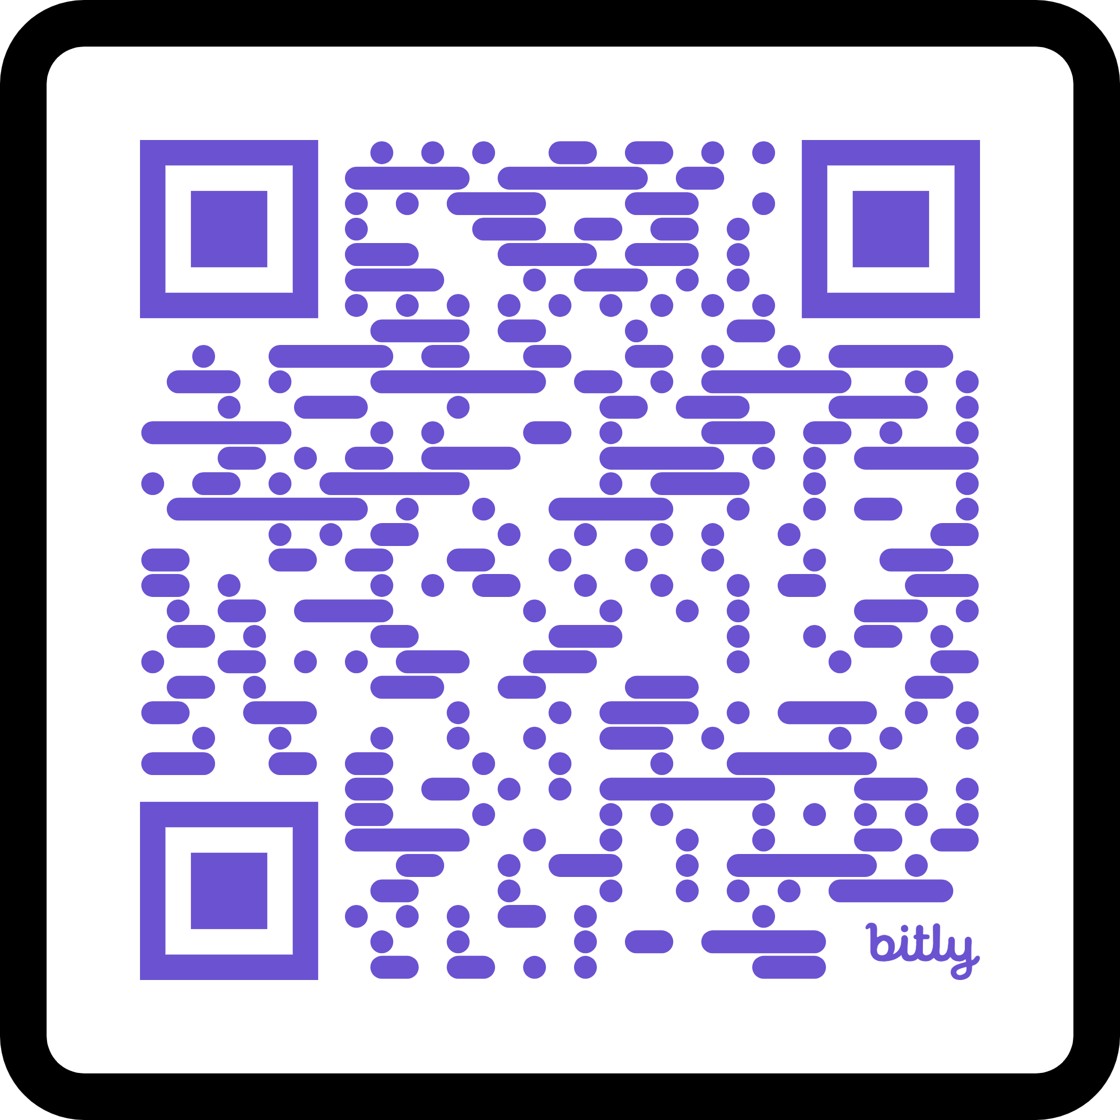
Thank You!
Slides
Scripts
Demos!
Extra resources
Contact info

